Slide 1

MAJOR PROJECT
ON
DETERMINING DUCTILITY AND BRITTLENESS OF STEEL USING DIGITAL IMAGE PROCESSING
Presented by:
BIBIDH BHARDWAJ Regd. No.- 2001105365
ABHIJEET PARIDA Regd. No.- 2001105352
ANSHUMAN DASH Regd. No.- 2121105053
Under The Supervision of:
Mr. GYANABRATA SAHOO
Assistant Professor
Department of Electronics and Telecommunication Engineering
Indira Gandhi Institute of Technology, Sarang
2023-24
Slide-1

Slide 2
CONTENTS
1. Introduction
2. Determining Ductility and Brittleness from Charpy Impact Test
3. Literature Survey
4. The Concept: Characterizing Fracture Surface Features
5. Methodology
6. Steps And Implementation
7. Result
8.Potential Applications and Future Directions
9.Conclusion
10.References
Slide-2
2

Slide 3
INTRODUCTION
Ductility means the quality of being flexible. Brittleness implies delicate easily breakable substance.
The Charpy test, has been used to determinate toughness analysis of metalic substances, and identification of different properties of materials.
One of the main drawbacks in determining brittleness and ductility is that it is associated with direct observation by experts through microscopic images. Human subjectivity is always a problem.
In this work, we estimated fragility and ductility of steel using AI model without human intervention.

Slide 4
OBJECTIVE
We have around 600 microscopic images of fractured part of steel. We have to label it by writing an appropriate code for it. We will use python code for this.
The basic fundamental is, the images with more contours are less ductile or brittle steel. The steel with less number of contours are more ductile.
Using the above concept we will write a code which when given an image of the steel returns its ductility and brittleness. Using this code first we will label all the data.
Using these labelled images we will train an AI model.
This AI model on giving any microscopic image of fractured part of steel should return its ductility and brittleness.

Slide 5
LITERATURE SURVEY
TITLE | AUTHOR | YEAR | RESULT
Obtaining the percentages of ductility and brittleness of AISI/SAE 1020 and 304 steels, using digital image processing | A D Rincon-Quintero et al | 2022 | The results of ductility percentage is found using area as form descriptor.
Application of Digital Image Processing Techniques to Detect Through-Thickness Crack in Hole Expansion Test | Daniel J. Cruz , Rui L. Amaral , Abel D. Santos | 2023 | This work describes a new method based on digital image processing techniques aimed at improving and automating crack detection and final diameter measurement in hole expansion tests.
Slide-3
5

Slide 6
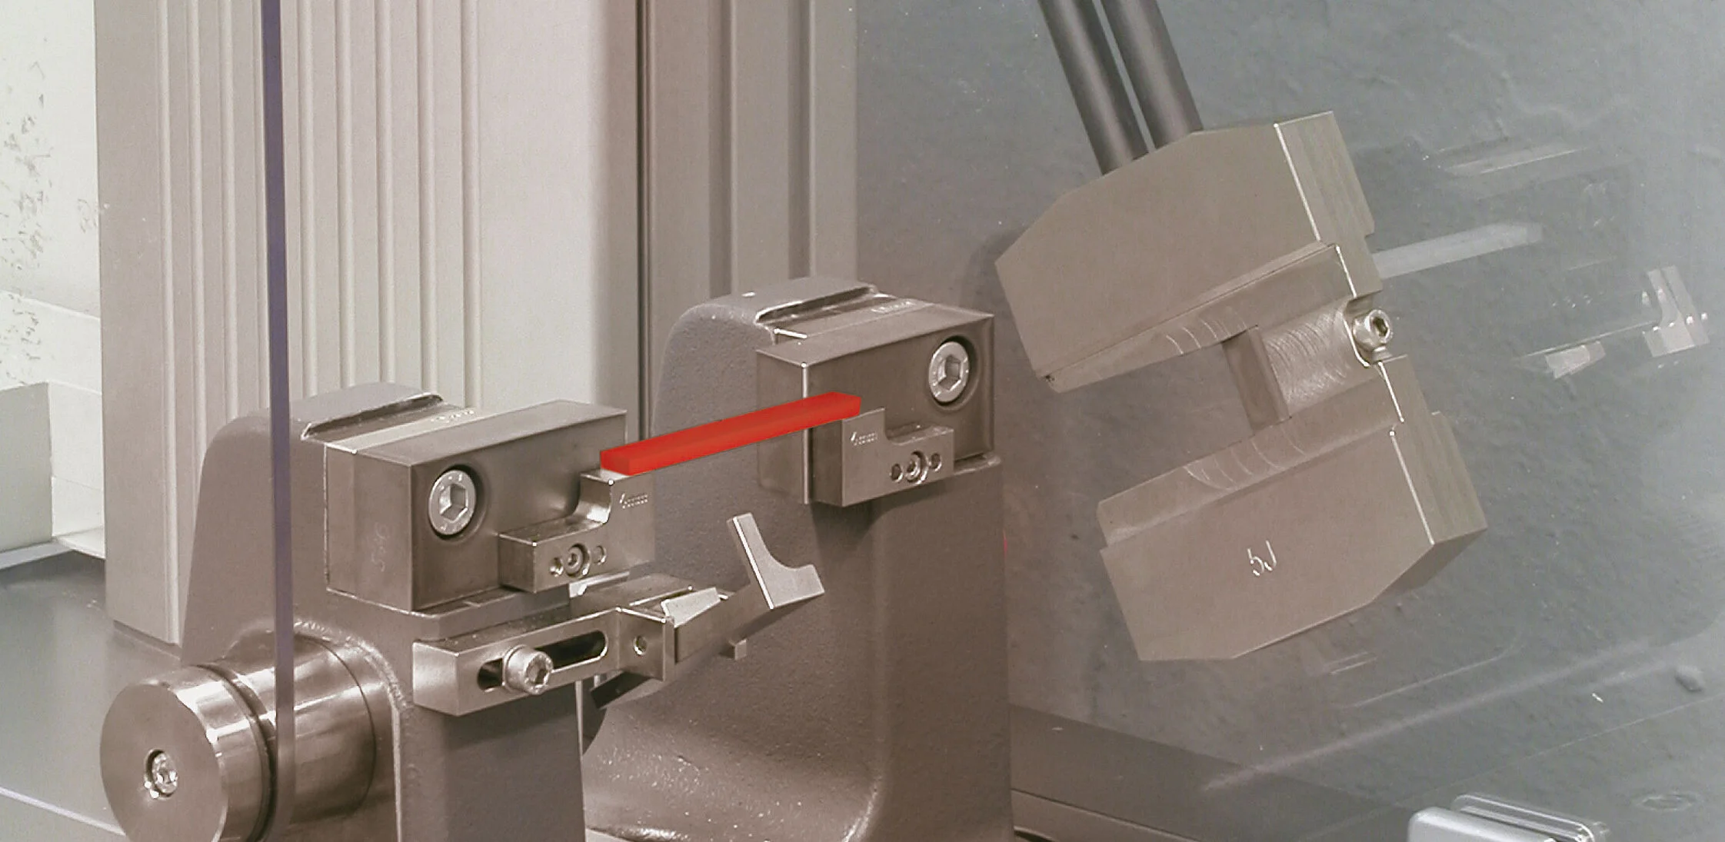
Determining Ductility and Brittleness from Charpy Impact Tests
The Charpy impact test is used to assess the toughness of metallic materials.
For the test, the specimen is centered in the pendulum impact tester and struck with the pendulum hammer and fractured.
By quantifying the percentages of ductile and brittle fracture regions on the specimen's fractured surface, materials scientists can gain crucial insights into a material's mechanical properties.
This project presents an innovative digital image processing approach to determine ductility and brittleness percentages.
Fig. 1
Slide-3
6

Slide 7
The Concept: Characterizing Fracture Surface Features
The brittle fractures leave behind larger patterns or marks on the broken surface compared to ductile fractures.
By taking pictures of the broken specimen surfaces and analyzing the sizes of the patterns or marks using image processing software, the researchers can figure out which regions were brittle fractures (larger patterns) versus ductile fractures (smaller, smoother patterns).
This allows them to calculate what percentage of the surface was brittle versus ductile
Using image analysis and comparing to reference pattern images avoids the inconsistencies that can happen when different people examine the same surface manually.
So in simple terms - larger crack/fracture patterns = brittle regions, while smoother torn areas = ductile regions.
Image processing quantifies the sizes to estimate the brittle versus ductile percentages objectively.
IGIT SARANG, ETC
Slide-4
7

Slide 8
METHODOLOGY
Marking the contours:
The select_brittle_fracture() function identifies potential brittle fracture areas
It first finds contours using OpenCV's findContours() function.
If contours are found, it iterates through each contour and calculates its area using cv2.contourArea().
If the contour area exceeds a specified threshold (in this case, 100 pixels), it is considered a potential brittle fracture area, and the contour is filled with white color using cv2.drawContours().
This process marks the identified brittle fracture regions within the binary mask.
Carrying out Charpy Test
Digitalization of image
Calculation of area
Algorithm to determine ductility and brittleness

Slide 9
Percentage calculation process :
Calculates the total number of pixels in the binary mask image.
Count the number of white (brittle) pixels using cv2.countNonZero().
The difference between the total number of pixels and the count of brittle pixels gives the count of ductile pixels.
By dividing these counts by the total number of pixels and multiplying by 100, the percentage of ductile and brittle areas in the image is calculated.

Slide 10
Steps And Implementation
Image Acquisition - High-quality digital images of the fracture surfaces from Charpy impact tested specimens are obtained. Computational approach is used to convert the acquired fracture surface images to binary format, where the fracture regions are represented by white pixels and the background is black.
Feature Extraction - Advanced image processing algorithms are employed to extract quantitative shape descriptors, such as the area and perimeter, from the distinct features observed on the fracture surface.
Contour Detection - The binary images are then processed using the OpenCV library's findContours
function, which identifies the outlines or contours of the fracture surface regions.
Model Training - Using the labelled data an AI model is trained based on supervised algorithm
IGIT SARANG, ETC
Slide-5
10

Slide 11
RESULT
When we give the image to the second code it will return the ductility and brittleness of the image along with its file name in notepad.
Image: Group A- Alredy tempered-Bottom1.tiff
Ductility Percentage: 47.46%
Brittleness Percentage: 52.54%
Image: QUW23-Tempering at 240C-24h.jpeg
Ductility Percentage: 8.60%
Brittleness Percentage: 91.40%
Image: Group A- Alredy tempered-Bottom3.tiff
Ductility Percentage: 63.05%
Brittleness Percentage: 36.95%
IGIT SARANG, ETC
11

Slide 12
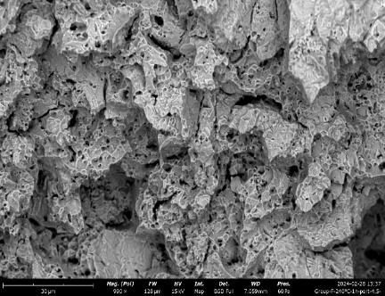
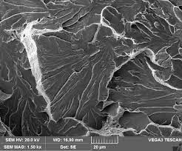
Output of the AI model :
Predicted Ductility: 54.84% Predicted Ductility: 33.66% Predicted Brittleness: 45.16% Predicted Brittleness: 66.34%
12

Slide 13
Potential Applications and Future Directions
Quality Control and Assurance
Standardization and Adoption
Materials Development and Research
The proposed methodology can be implemented as a valuable tool for quality control and assurance in materials manufacturing and testing processes
As the research and development in this field progresses, the potential exists for the digital image processing methodology to be incorporated into industry standards and best practices.
This digital image processing approach can also contribute to materials development and design and optimization of new alloys and materials.
IGIT SARANG, ETC
Slide-8
13

Slide 14
CONCLUSION
The digital image processing approach presented in this report offers a significant advancement in the characterization of ductility and brittleness from Charpy impact test fracture surfaces, moving beyond the limitations of traditional.
By leveraging computer vision and pattern recognition techniques, this methodology provides an objective and quantitative means of assessing the proportions of brittle and ductile fracture regions.
As the research and development in this field continue, the potential for this digital image processing approach to be incorporated into industry standards and best practices holds promise for the widespread adoption.
We have tried to create an AI model which will directly return the ductility and brittle percentage using the microscopic image of the fractured steel.

Slide 15
REFERENCES
[1] P. J. Bagga, M. A. Makhesana, K. Patel, and K. M. Patel, “Tool wear monitoring in turning using
image processing techniques,” Mater. Today Proc., vol. 44, pp. 771–775, 2021.
[2] N. Dey, J. Chaki, L. Moraru, S. Fong, and X.-S. Yang, “Firefly Algorithm and Its Variants in Digital Image Processing: A Comprehensive Review,” in Applications of Firefly Algorithm and its Variants: Case Studies and New Developments, N. Dey, Ed. Singapore: Springer Singapore, 2020, pp. 1–28.
[3] E. R. Dougherty, Digital image processing methods. CRC Press, 2020.
[4] G. K. Ijemaru et al., “Image processing system using MATLAB-based analytics,” Bull. Electr. Eng.Informatics, vol. 10, no. 5, pp. 2566–2577, 2021.
[5] P. Salehi and N. Behzadfar, “Investigation and simulation of different medical image processing algorithms to improve image quality using simulink matlab,” Signal Process. Renew. Energy, vol. 5, no. 4, pp. 15–28, 2021.
[6] O. Cantó-Navés, X. Marimon, M. Ferrer, and J. Cabratosa-Termes, “Comparison between experimental digital image processing and numerical methods for stress analysis in dental implants with different restorative materials,” J. Mech. Behav. Biomed. Mater., vol. 113, p. 104092, 2021.
[7] S. Mahankali and G. Valikala, “Comparison of Compressive Strength of M30 Grade Concrete with Destructive and Nondestructive Procedures Using Digital Image Processing as a Technique,” Adv. Civ. Eng., vol. 2022, 2022.
15

Slide 16


